Slide 1
Team Computing - Introduction
TU857/1 Semester 2 2024
Lecturer: Dr. Cathy Ennis
Email: cathy.ennis@tudublin.ie

Slide 2
Credits
This course is based on material developed by :
Cathy Ennis
Dr. Paul Doyle
Material from other sources is also used (citations included)

Slide 3



Overview
Preliminaries
Module Overview
Applied Computing
EV3 Robot
Programming Robots
Teams & Groups
Assessment & Protocols

Slide 4
Module Learning Outcomes
Define what a robot system is and discuss the applications of robot technology.
Explain and compare the operations, characteristics and applications of robot sensors and actuators.
Explain and compare different approaches to robot control.
List the difficulties facing the development of hardware-based real-time software systems.
Demonstrate the ability to implement software to run on a specific hardware base, for example a robot.
Demonstrate an ability to work productively in a team.

Slide 5
Today’s Learning Outcomes
Define what a robot system is and discuss the applications of robot technology
Demonstrate the ability to implement software to run on a specific hardware base, for example a robot (using a simulator)
Demonstrate an ability to work productively in a team

Slide 6
PRELIMINARIES

Slide 7
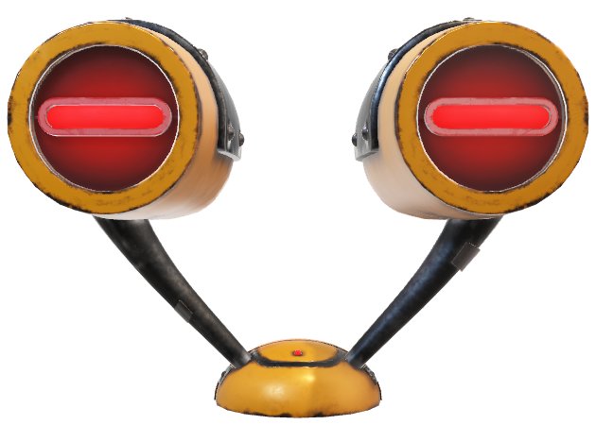
My Details
Team Computing (Robotics) CMPU1030: 2023-24
Name: Cathy Ennis
Email: cathy.ennis@tudublin.ie
Brightspace (Notes, Labs):
Module: Team Computing (Robotics) CMPU1030: 2023-24
Module Code: CMPU103022497TU857-2324

Slide 8
Course Details
Lectures: Wednesday 9am
Labs: Wednesday 10am-1pm
Assessment: Weekly Labs (100%)

Slide 9
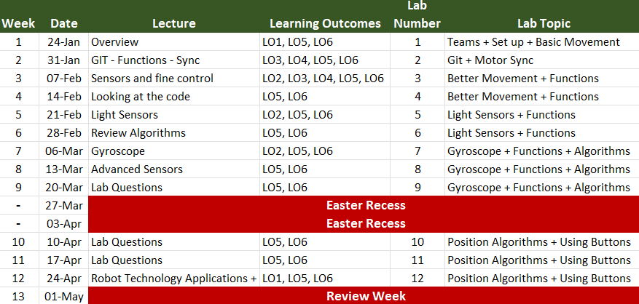
Course Overview

Slide 10

Applied Computing
Learn how to program
Mobile Robots
Working in Teams
Improve your coding skills
Enjoy programming
Notes:
Why?

Slide 11
Before we get started
Contact me using the class rep for general issues
Other issues contact me directly
Attendances is taken – marks awarded!
Plagiarism will be dealt with formally in ALL cases
This is 100% continuous assessment (what does that mean if you fail?)
There is no project

Slide 12
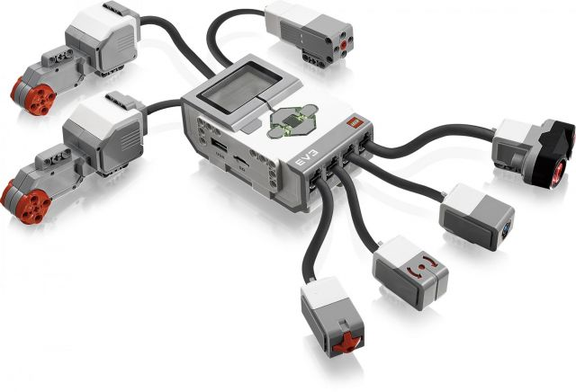
EV3 Robot
Notes:
Complex performance with simple functions

Slide 13
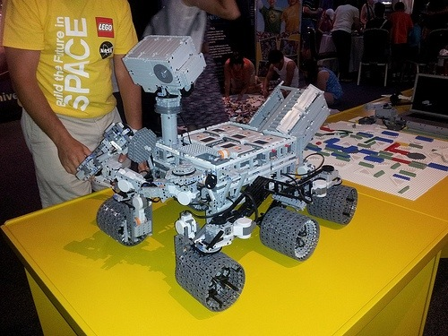
NASA's Curiosity Rover Replica With Lego Mindstorms
Notes:
Mindstorms have been around since 1998 – soon to be discontinued…

Slide 14
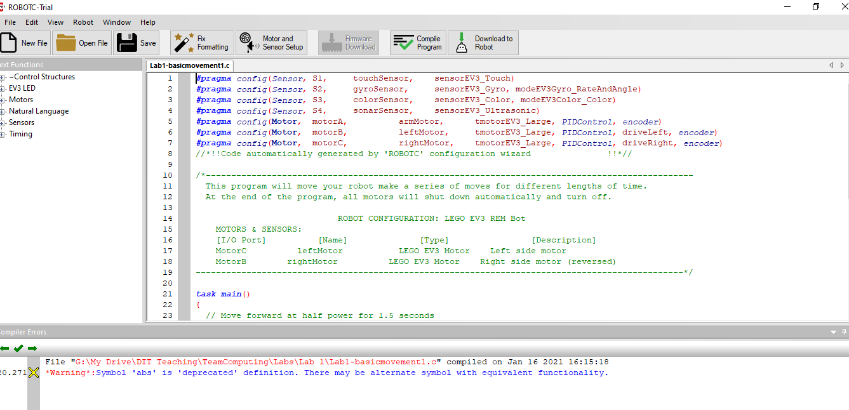
RobotC in Campus Labs

Slide 15
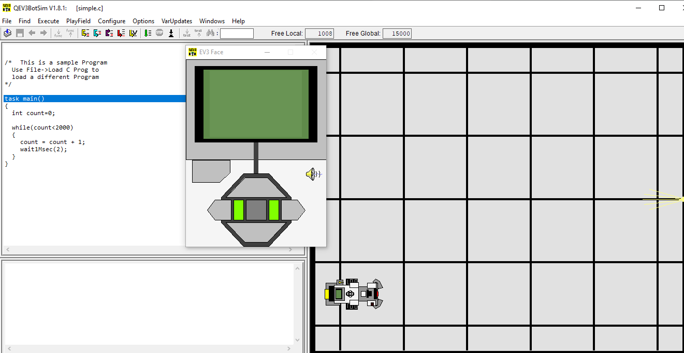
QEV3 Bot Simulator for Testing at Home

Slide 16
QEV3 Bot Simulator for Testing at Home
Free, real-time Windows-based graphical simulator that accurately models a QEV3Bot running any RobotC program on one of three chosen walled "PlayFields“
Once loaded into QEV3BotSim, programs can be tested, and can be easily modified in a syntax-colourized Edit/View window, then recompiled for re-testing
Users can Run, Halt, Step, Step-Into, Step-Out-Of, Step-Over and RunTo a breakpoint for debugging purposes. All global and local user variables and arrays, as well as relevant built-in EV3 variables and arrays, are displayed during execution

Slide 17
Components

Slide 18
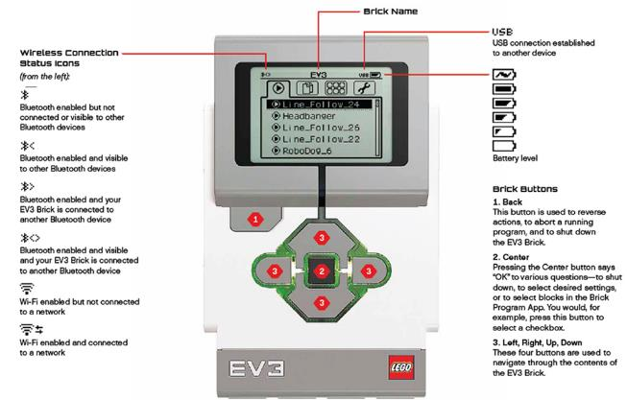
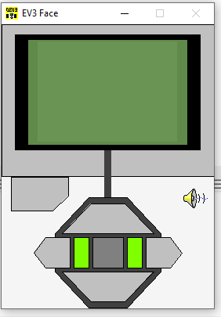
EV3 Robot
EV3 Programmable Brick It contains a 32-bit processor with 4 input ports and 4 output ports, a matrix display, a speaker, USB, Bluetooth.

Slide 19
EV3 Robot
EV3 Programmable Brick It contains a 32-bit processor with 4 input ports and 4 output ports, a matrix display, a speaker, USB, Bluetooth.

Slide 20
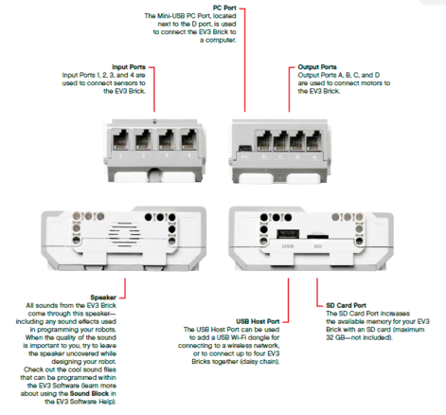
EV3 Robot

Slide 21
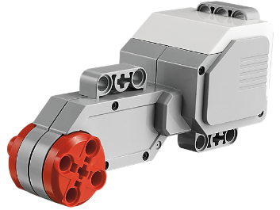
EV3 Robot - Motors
Servo motors: we send commands to these motors to move the robot around. In robotics motors are often called actuators because they enable the robot to perform actions

Slide 22
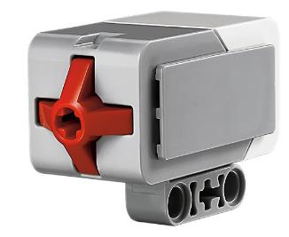
EV3 Robot - Sensors
Touch sensor reacts to touch or release
What would this be useful for?
We can use this sensor to check if the robot has bumped into anything

Slide 23
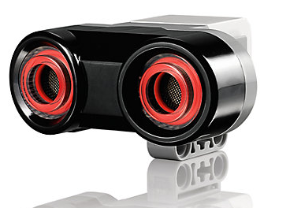
EV3 Robot - Sensors
Ultrasonic sensor: using this sensor the robot can find out the distance between it and an object that is close by
This type of sensor is often called a range sensor
When would this be useful?
If you are searching the environment and want to find the closest object

Slide 24
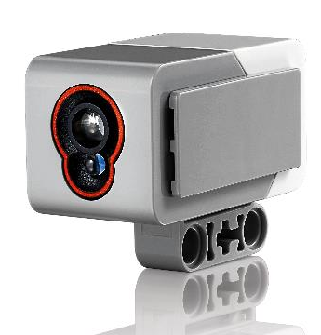
EV3 Robot - Sensors
Light sensor: this sensor detects different colours and light intensity – your robot’s eyes!
What could this be useful for?
We would use this sensor if we want to get the robot to follow a specific coloured line

Slide 25
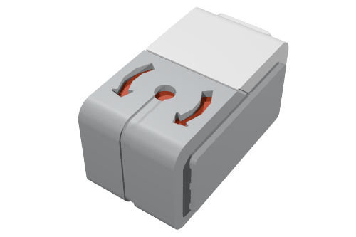
EV3 Robot - Sensors
Gyro sensor: this sensor can measure the robot’s rotational motion and changes in its orientation
Use it to measure angles, create balancing robots and explore the technology that powers a variety of real-world tools like navigation systems and game controllers

Slide 26
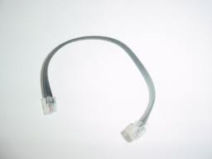
EV3 Robot - Connections
Cables: These allow you to connect your sensors to the output ports of your brick – so you can instruct your robot!
Similar to old phone cables

Slide 27
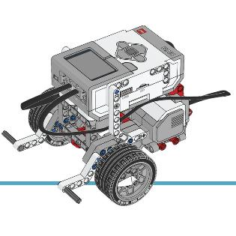
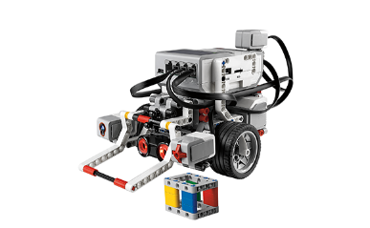
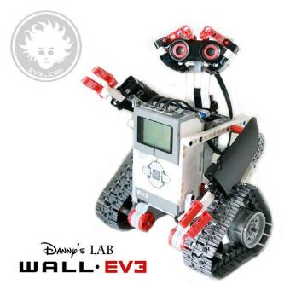
EV3 Robot- Configurations

Slide 28
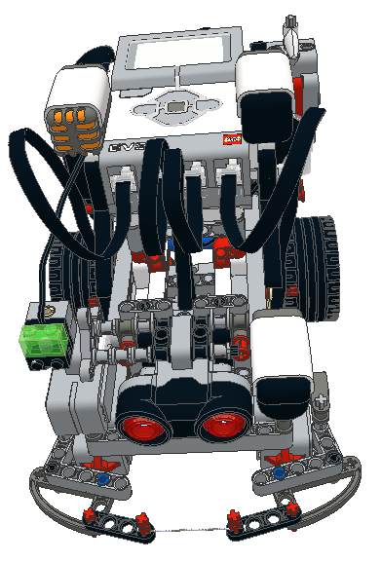
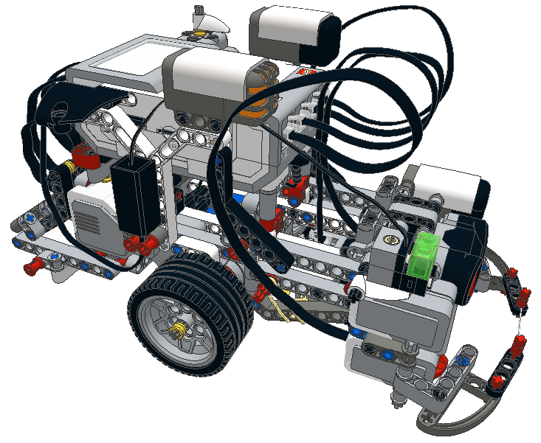
QEV3 Robot Configuration
a pair of front contact sensors which allows contact detection over a wide range of angles, whether driving forward or turns
front-mounted ultrasonic ranging, gyroscope, and IR-seeker sensors.
centre-mounted downward-looking color/light sensor
EV3-brick-mounted NXT sound and HiTechnic 3-axis accelerometer sensors.
optional NXT-kit incandescent headlamp assembly on motor port A
Light/colour sensor
Notes:
This can’t be changed

Slide 29
Programming Robots
Robots are made to perform useful tasks
Searching, fetching, navigating
Each one is designed to solve a specific problem, in a specific way
Creating a successful robot takes a team effort between humans and machines
Design of solution is important!
Working with hardware and software

Slide 30
Programming Robots
Role of the Programmer
Role of the Robot
The human is responsible for
identifying the task
planning out a solution
then explaining to the robot what it needs to do to reach the goal
The machine is responsible for following the instructions it is given, and carrying out the plan

Slide 31

Programming Robots
A special programming language must be used to translate the necessary instructions from human to robot
There are many such languages: in this class we will use the with ROBOTC programming language
This language is similar to the C programming language you have already learned

Slide 32
Teams and Labs
You will work with this team for the duration of the course
Teams are not changeable unless if you have a fantastically amazing justification!

Slide 33
Labs
3 concurrent Labs WED 10am-1pm
Group A: Edina Hatunic-Webster
Group B: Cathy Ennis
Group C : Art Sloan
I will change labs during the term at different times to see all groups

Slide 34
Lab 1 Preview
TEAM: Find your teammate(s)
TEAM: Read the Webcourses lab 1 material
Team Building
Thinking about Programming
TEAM: Physical Robot
Building the ROBOT
Download EV3 Firmware to Physical Robot
Download sample programs to the EV3 ROBOT and run them
Label your BOX
TEAM: Simulator
Download QEV3 Bot Sim to simulate our physical EV3 Robot, or run on lab machine
Download sample programs to the simulator and run them
TEAM: Download the Lab 1 sample programs from Brightspace
TEAM: Modify the initial sample program so that you get the robot to do a set of specific tasks
TEAM: Complete the Lab Theory and Submit your code via Brightspace

Slide 35
Assessment
Assessment is based on completing your Labsheet Part A & Part B each week. You demonstrate your answers/code the following week during the lab.
Code and answers to Quiz questions must be submitted to a private GIT Repo from week 2 onwards (more about this next week)
For week 1 just submit your code via Brightspace. Deadline is Sunday 11pm

Slide 36
Assessment Breakdown
Weekly Assessment only, no project
Some labs are longer than others and will span 2 weeks or more – you must be here for all labs to get marks
If you miss one week of a 2 week lab, you get 50% of the grade for that work
No “catch up” CA will be assigned
No Exam…. just labs
Marks are only assigned if you are present to demonstrate the code
Usually marks will be assigned equally for each team-mate. However if the lab supervisors is unhappy with the teamwork an adjustment may apply as appropriate

Slide 37
Course Overview
Building the Robot & Basic Movement
Advanced Movement, GIT & using functions
Ultrasonic and Bump Sensors
Light & Sounds Sensor
Using the Display
Multiple Sensors
Mapping Challenge

Slide 38
Weekly Overview
Week 1 – Overview of EV3 module & basic movement
Week 2 – More motor control and using GIT
Week 3 – Encoders & Sensor introduction
Week 4 – Light Sensors
Week 5 – Gyro, Buttons, LCD & LED
Week 6 – Multiple Sensors
Week 7 – File Control
Week 8 – Algorithms
Week 9 - Mapping Challenge part 1
Easter Week 1
Easter Week 2
Week 10 – Mapping Challenge part 2
Week 11 - Avoiding Obstacles while mapping 1
Week 12 – Avoiding Obstacles while mapping 2

Slide 39
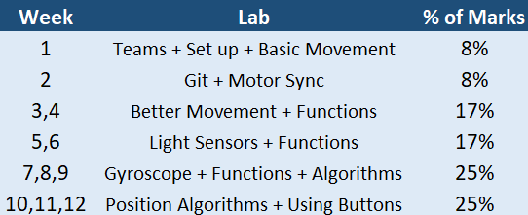
Lab Breakdown

Slide 40
Movement and Motors
The most basic kind of statement in ROBOTC simply gives a command to the robot
We move a robot by putting power to the motor then leaving it run for a period of time
We will use the IDE for ROBOTC which allows us to configure some of the motor names etc

Slide 41
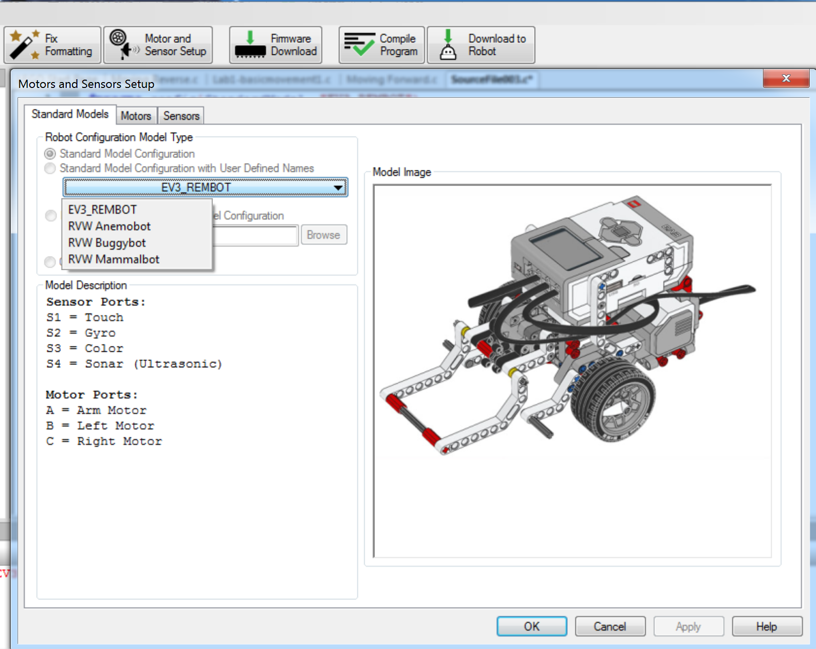
IDE

Slide 42
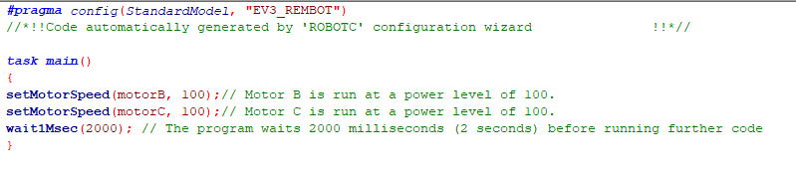
Motors in RobotC

Slide 43
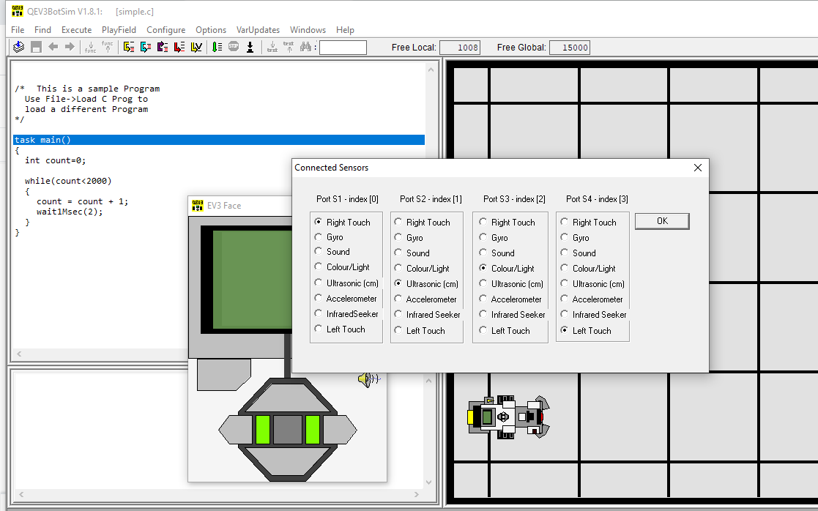
Set Up Sensors In QEV3BotSim

Slide 44
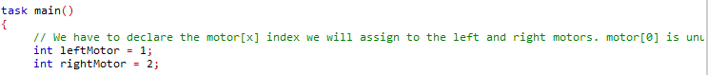
Motors in QEV3BotSim
EV3 have an array for the motors:
motor[0], motor[1], motor[2]
We will use motor[1] and motor[2] for our left and right wheels in all our labs
You will need to declare these at the start to use the ‘left motor’ and ‘right motor’ variables

Slide 45
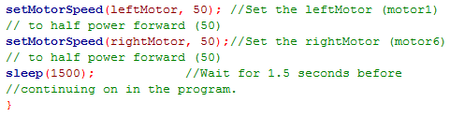
Motors in QEV3BotSim

Slide 46
Statements
Statements are run in order, as quickly as the robot is able to reach them
Running this program on the robot turns the motor on, then waits for 1500 milliseconds (1.5 seconds) with the motor still running, and then ends
When it ends, the motors will stop
If we don’t “wait” then the program will end almost instantly

Slide 47
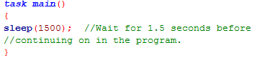
task main()
One important structure is the task main
Every ROBOTC program includes a special section called task main
This control structure determines what code the robot will run as part of the main program

Slide 48
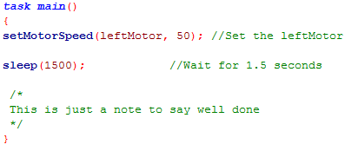
Comments

Slide 49
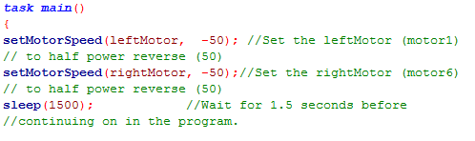
Speed and Direction (Reverse)

Slide 50
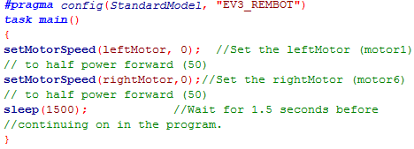
Speed and Direction (STOP)

Slide 51
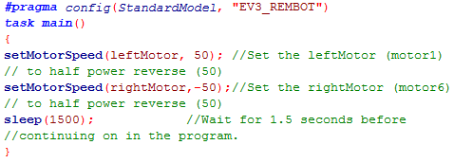
Speed and Direction (Rotate)

Slide 52
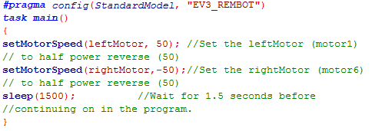
Distance/time to Rotate

Slide 53
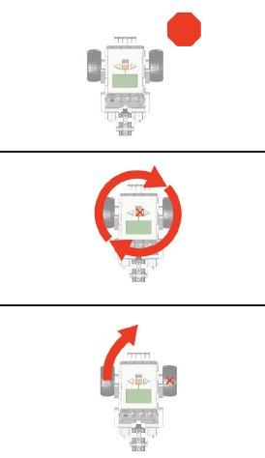
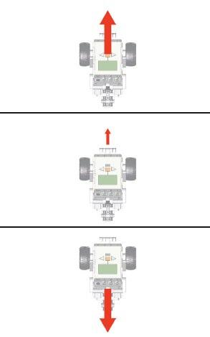
Motor Control

Slide 54
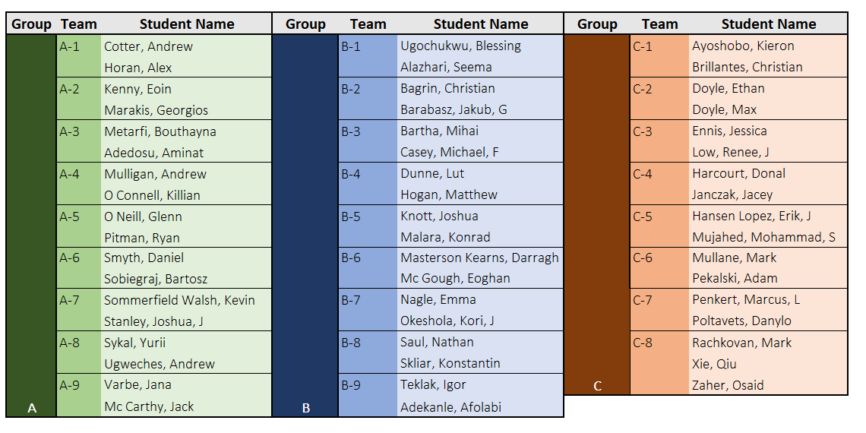
Teams – also on Brightspace

